Slide 1
Mission on organizational capacity and strategy for strategic purchasing
WRAP-UP
14.11.2018
WHO UHC Partnership in Georgia

Slide 2
SSA SP Organization (version 1, Aug 2018)
Deputy Director on Health Care
Health Economics
HBP
Pricing
Provider relations
Claims management
Beneficiary relations
Q & P evaluation
Contracting
Reporting

Slide 3
SSA SP Organization (version 2, Nov 2018)
Deputy Director on Health Care
HBP
Pricing, payment methods
Provider relations
Contracting
Beneficiary relations
Q & P evaluation
Claims management
Pharmaceuticals
Planning, Monitoring & Evaluation

Slide 4
SSA structure feedback (version 2 vs version 1)
We recommend to keep the position of Deputy Director for Health separate from Director of SSA.
Integration of Vertical Programs and UHC is recommended, regardless that regulation and principles of these two may vary. Within one unit different people can take care of both, gradually overcoming separation of two kind of services.
Consider adding Pharmaceuticals under HBP.
Planning, Monitoring and Evaluation to provide broader strategy coordination, support evaluation and reporting for entire SP area.
Claims management is complex process, it is not not recommended to separate monitoring and control unit from handling claims management.
Quality and Contracting Performance evaluation to keep within or under the Contracting unit.

Slide 5
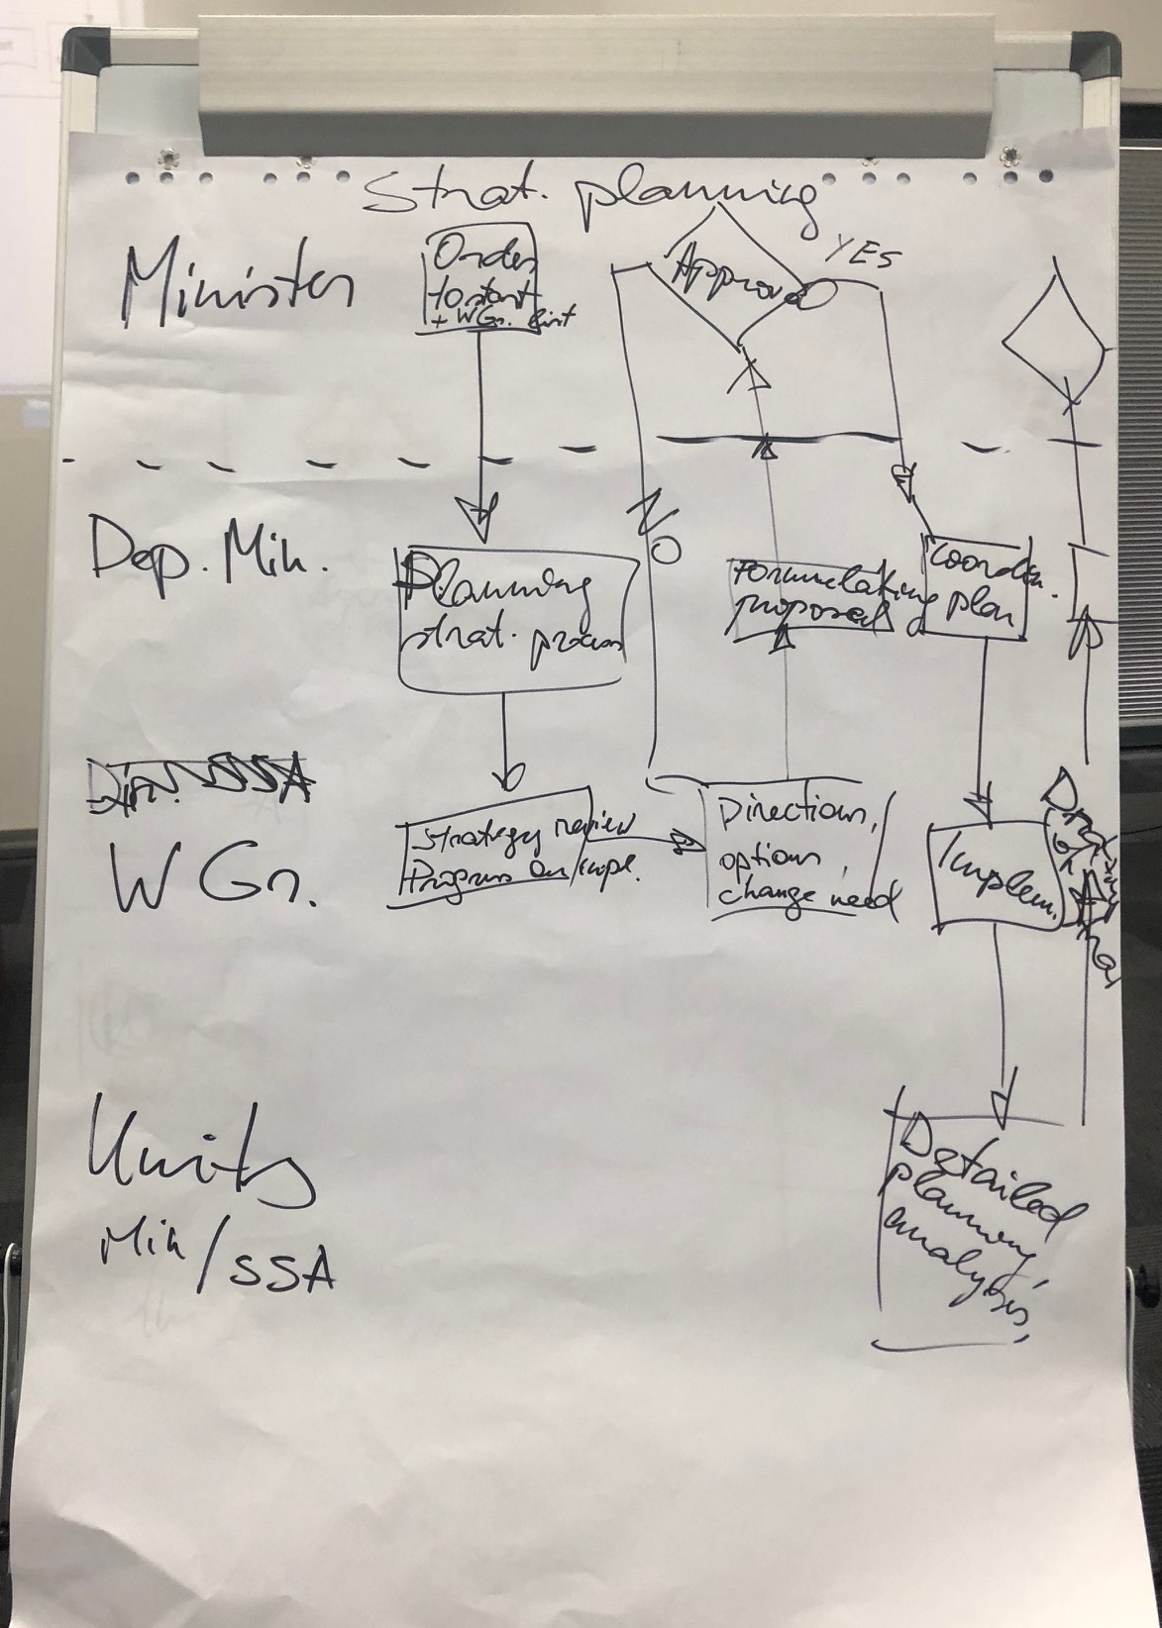
Strategic planning
“Owner” of master planning is very important
Strategic planning in rolling planning principle, renewing the strategy annually
Strategic planning integrates both – the Ministry and SSA

Slide 6
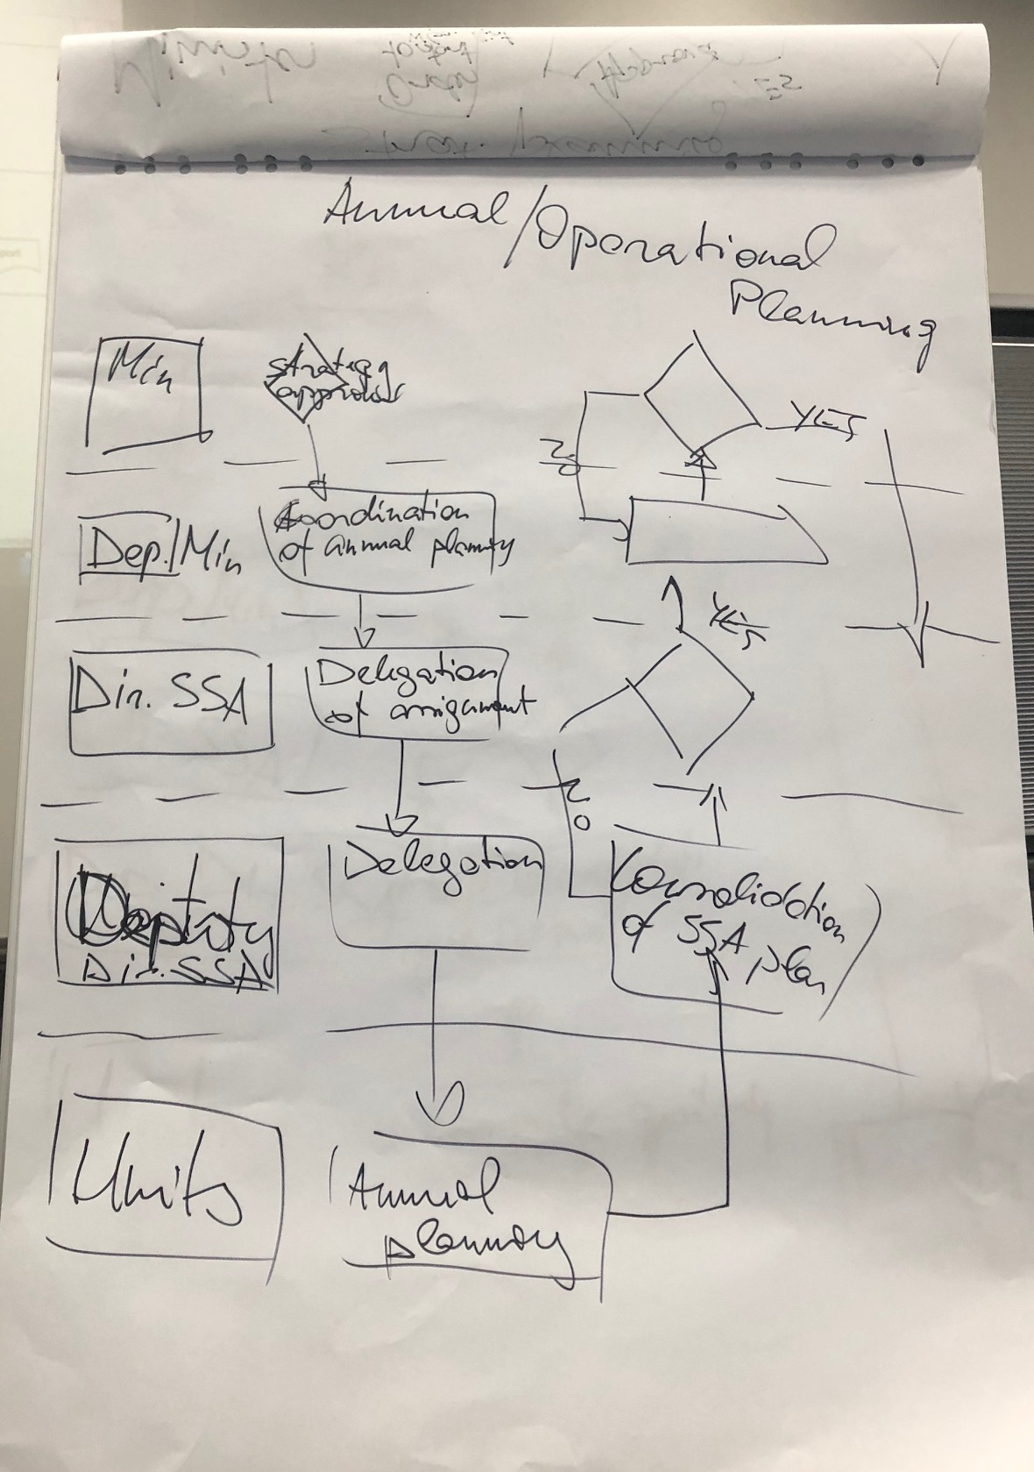
Annual planning
Quarterly milestones with clear definition are recommended for strategic initiatives

Slide 7
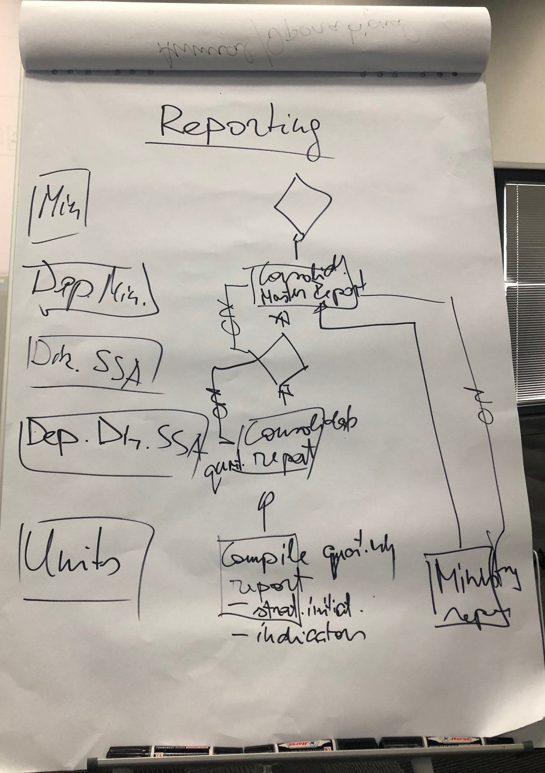
Reporting
Reporting to cover quarterly milestone plan of initiatives with short and clear statement
Reporting to cover indicators with explanation

Slide 8
Competency development
Derive the need for competency from strategy, focus on priorities
Translate it to specific competency categories, avoid too general definitions
Link competencies with specific target groups
Define competency development sources – there are many ways to contribute
Remember – competency development is everyone responsibility, an organization should support it and create relevant environment!

Slide 9
Next steps: SP Strategy for the period 2019-2022
Activity | Agreed due date in August | Revised due date
SPS WG preparing strategic initiatives focusing on IT and HR | October 15 | November 30
SPS WG prepares the 3Q2018 report | October 15 | Done
“Strategy day” for the critical review of the SP Strategy | during next mission | Done
Drafting missing chapters: strategy map, strategic initiatives and indicators; Strategy execution framework, planning and reporting, governance | Guidance for the SPS WG – September 30 1st draft by the SPS WG – October 30 | Reporting and planning process diagrams – November 24
SPS WG prepares the 1st draft for the SP Strategy for the period 2019-2022 (focus on initiatives-activities and planning + reporting) | November 30 | November 30
Final review of the SP Strategy | Next mission | December 10-11
Final SP Strategy for the period 2019-2022 | December 31 | December 31

Slide 10
Additional next steps
SPS WG revises claims management process diagram by November 19
HR competences and training needs planning for agreed key strategic areas:
  WHO additional guidance by November 30
  SPS WG sends initial plan by December 7
Next mission: December 10-11

